Slide 1

Introduction to the End

Slide 2
Keywords
Print in place
DIY
Supported
Nozzle
Soldering
.stl .step .3mf
.gcode .gx
Wiring scheme
Volt
Notes:
https://all3dp.com/2/coolest-print-in-place-3d-models/

Slide 3

Congratulations! You've Unlocked the Achievement!
Saldatura
Progettazione 3D
Stampa 3D FDM
Stampa 3D SLA
Operare in sicurezza
Notes:
Congratulations on your successful completion of our course! We hope you found it informative and enjoyable. You can now apply your new skills and knowledge in your career. Join our community of successful professionals, and keep up the good work!

Slide 4
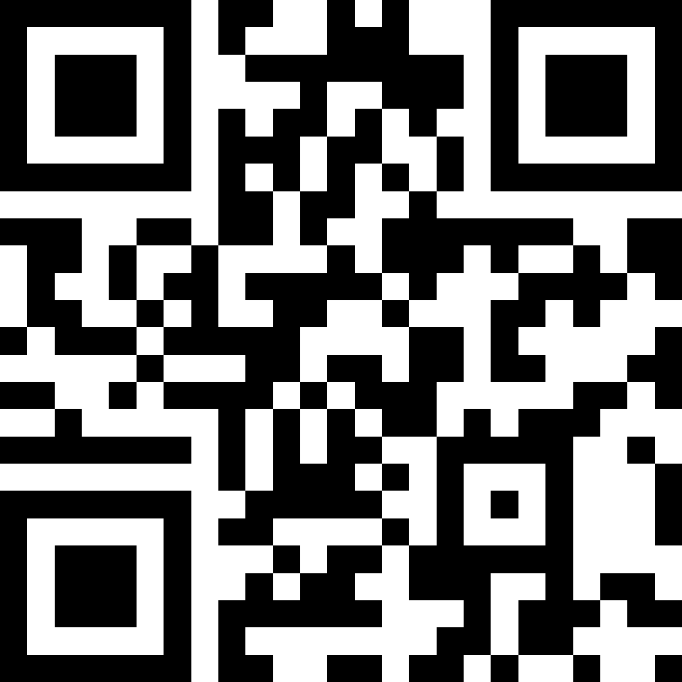
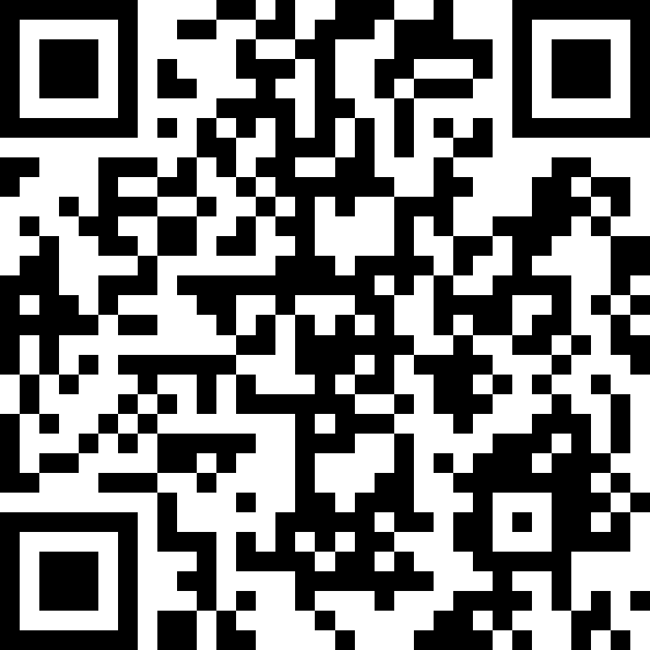
Contatti
Canale Telegram
https://francescopenasa.github.io/

